Slide 1
UCP 0010 – Research Methodology 19th Nov 2016
MODULE 1
INTRODUCTION TO RESEARCH
Professor Dr Naomie Salim
/
Muhammad Murad Khan

Slide 2
Course Learning Outcome
Able to comprehend the process of conducting academic research
Able to identify and formulate research problem by critically analysis of current research papers
Able to design suitable techniques/methodology for proposed research
Able to write and present research proposal/thesis

Slide 3
Outline
About the course
What is research
Research in Computer Science
Training to become a Researcher
Expectation of a PhD research

Slide 4

About the Course

Slide 5
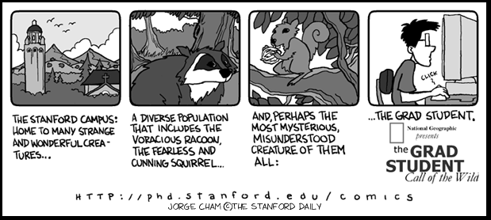
Audience of Class
Doctor of Philosophy (Computer Science)
Master of Science (Computer Science) (by research)

Slide 6
Other Evaluation
Marking
40 + 40 + 40
40: internal examiners
40: external examiners
40: publications
Research paper submission

Slide 7
M.Phil
Is an advanced postgraduate research degree.
The prerequisites required for a Master of Philosophy degree make it the most advanced research degree before the Doctor of Philosophy (Ph.D. or D.Phil.)
Should have flavour of research

Slide 8

Circle Contains All Human Knowledge

Slide 9

When you finish primary school

Slide 10

When you finish secondary school

Slide 11

When you finish undergrad

Slide 12

When you finish a Master’s degree

Slide 13
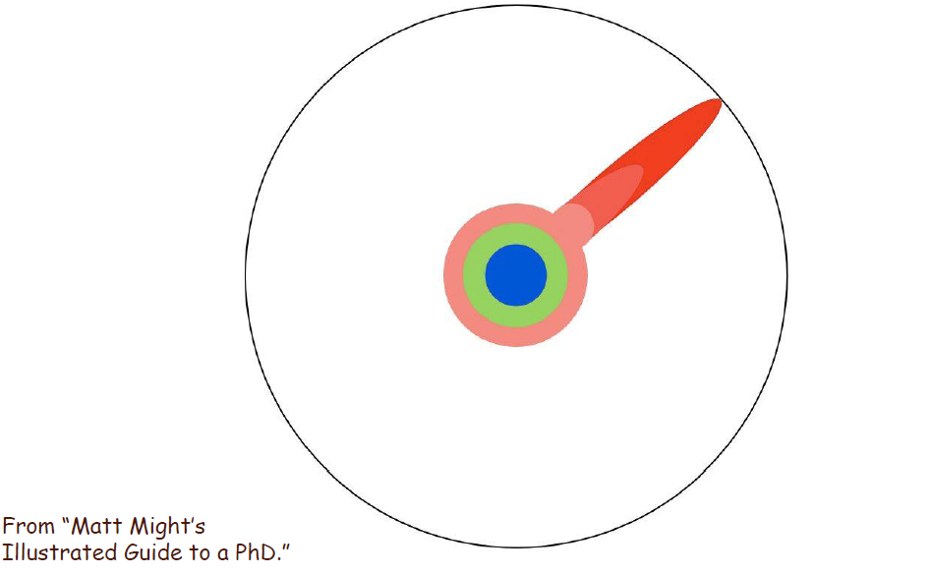
Reading research papers takes you to the edge

Slide 14
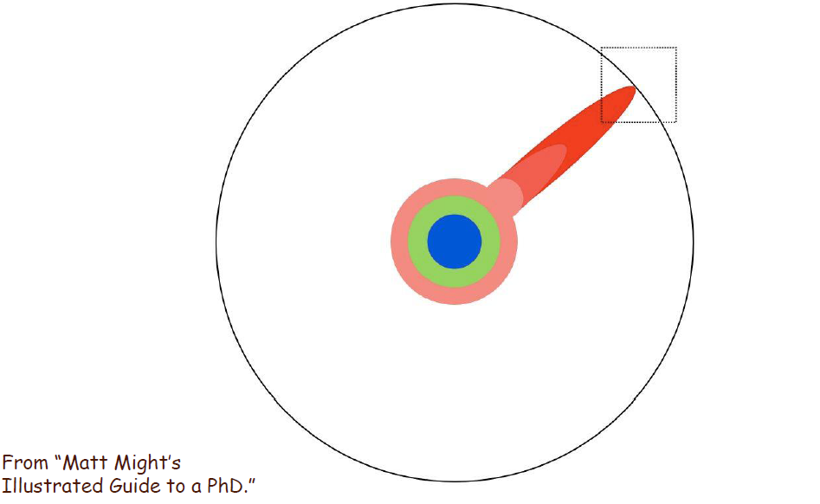
At the boundary, you focus

Slide 15

You push at the boundary for several years…

Slide 16
What is Research?

Slide 17
What is Research?
Research is the method used to accumulate scientific knowledge.(Roscoe, J.T. 1975)
Research is a systematic search for new knowledge
Research is an organized scientific investigation to solve problems, test hypotheses, develop or invent new products
Research can use the scientific method, but need not do so.

Slide 18
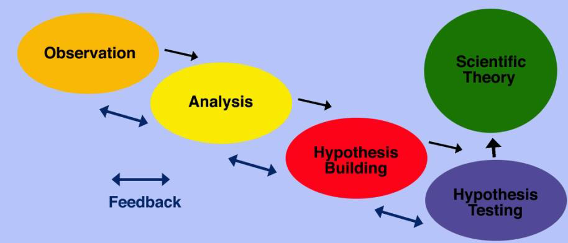
What is the Scientific Method?
•
Formulation, testing, and modification of
hypotheses
• Systematic
2
- observation,
- measurement, and
- experiment,
1 Oxford English Dictionary
2 Indiana University

Slide 19
Research – Scientific Method
Observation
A general problem area (research topic) is defined
Then pertinent observations are made via literature review, discussions and experiments
Problem Definition
From the observations, specific questions are asked
And the problem to be addressed is defined
Hypothesis Generation
From the questions asked, researcher makes a specific guess or provide an idea about what is going on.
Objectives are defined
Appropriates methods are selected for testing

Slide 20
Important Characteristic of Research
Systematic
Work in a sequence of steps which were in order and thus systematic
Order: Observation, Problem Definition, Hypothesis, Testing, Conclusion
Follows a scientific method of enquiry
Researcher should not just jump at the conclusions,
But used a scientific method of enquiry in reaching conclusion

Slide 21
What Research is NOT?
Research is not information gathering
Gathering information from resources such as books or magazines.
No contribution to new knowledge
Research is not the transformation of facts
No contribution to new knowledge although this might make knowledge more accessible.
INSPIRING CREATIVE AND INNOVATIVE MINDS

Slide 22
Research is NOT a SIMPLE Linear Activity
Never more in a straight line.
Always loops back & forth.
Manage the parts in order to manage the whole.
Searching for something you won’t know until you find it.
Nobody can solve the world’s great problems in a tiny project.
INSPIRING CREATIVE AND INNOVATIVE MINDS

Slide 23
Characteristics of High Quality Research
It is based on the work of others.
It can be replicated (duplicated).
It is generalizable to other settings.
It is based on some logical rationale and tied to theory.
It is doable!
It generates new questions or is cyclical in nature.
It is an activity that should be undertaken for the betterment of society

Slide 24
Bad Research
The opposites of what have been discussed.
Plagiarizing other people’s work.
Falsifying data to prove a point.
Misrepresenting information and misleading participants.

Slide 25
Research Process
Literature Review
Research Problem/ Research question(s)
Survey
Design & creation
Strategies
Action Research
Ethnography
Grounded Theory
Data generation methods
Data analysis
Experiment
Conceptual Framework
Observation
Case Study
Interviews
Documents
Questionnaires
Qualitative
Quantitative
Outcome
Framework
Model
Algorithm
System
Application

